Slide 1
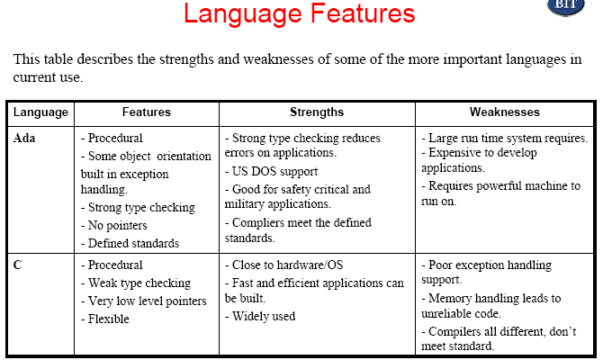

Slide 2
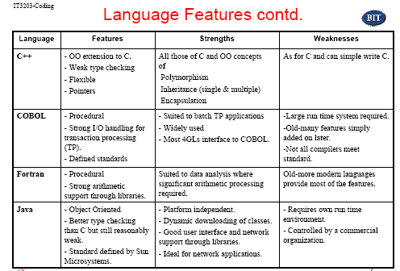

Slide 3
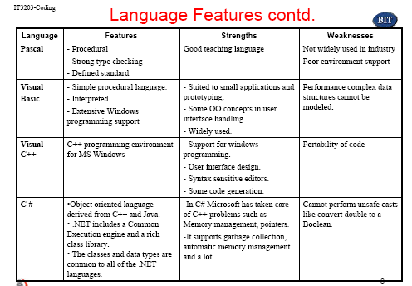

Slide 4
Selecting Languages and Tools
• There's no language suitable for all tasks, and there probably
won't ever be one.
• When choosing a programming language, you have to
balance programmer productivity, maintainability, efficiency,
portability, tool support, and software and hardware
interfaces.
• Often, one of these factors will shape your decision. In other
cases, the choice depends on the productivity you gain from
certain language features, such as modularity and type
checking, or external factors, such as integrated development
environment support.
• Finally, for some tasks, adopting an existing domain-specific
language, building a new one, or using a general-purpose
declarative language can be the right choice.

Slide 5
Coding Practices
• Allow code to be written in a more predictable and
maintainable fashion.
• While working code can be written without these
techniques it is rare for such code to be maintainable
other than by the original author.
• There are three main areas to consider;
– Reliability -> Is the software fault free?
Two complementary approaches:
• Fault avoidance-develop so that errors are not introduced.
• Fault tolerance-develop so that the program continues when
faults occur.
– Readability -> can be code to be easily maintained.
– Reuse -> can the code be used again.

Slide 6
Programming for reliability
• Reliable code is that which conforms to its specification
and continues in operation in all but most extreme
circumstances.
• There are two techniques used to increase the reliability
of code, avoidance and tolerance.
• Following structured programming techniques leads to
code that is less likely to have faults and is easier to
correct.
– Fault avoidance
Aims to ensure the code has few errors as possible.
– Fault tolerance

Slide 7
Fault tolerance
Aims to produce code that will continue to function
in the presence of errors.
Fault tolerance includes:
• Exception Handling
• Defensive programming
• Fault recovery

Slide 8
Exception Handling
• An exception is an error or unexpected event. Traditional
languages, Pascal, C etc. have no specific support for
handling exceptions, newer languages, Ada, Java, have
some in built exception handling.
• Example:
Procedure A calls Procedure B
Procedure B calls Procedure C
An exception occurs in procedure C
B cannot continue Need to signal exception to A

Slide 9
Exception Handling contd.
• With traditional languages we must resort to setting error or status
variables which can be shared or passed from procedure to
procedure, for example:
/* allocate an integer array of SIZE elements */
int *intArray = (int *)malloc(SIZE);
if (intArray =» NULL)
{
/* no heap memory available */
error - MEMORY_ERROR;
return -1;
}
• Still have to unwind the nested function calls.
• Some people advocate the use of goto and exit() to handle errors in
C programs, this is not a good solution in most circumstances.
Requires the program to terminate on an error and it is difficult to
tidy up, close files and database connections, free all memory etc.,
from a single error handling routine.

Slide 10
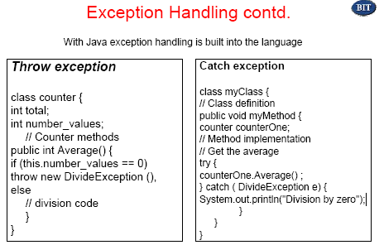

Slide 11
Defensive programming
• Assume that there are faults and inconsistencies in the
system and validate data. Example checks are:
• internal data states, for example probabilities between 0
and 1, money = integer + 2 decimal places etc.
• checksums
• array bounds checking
• division by 0
• pointer validation - check that pointer is allocated and
points to a data structure.
• If any problems occur then the system must recover to a
safe state.

Slide 12
Fault recovery
• Forward recovery, correct damaged system state
• error detection and correction of coded data
• file or database recovery
• Backward recovery, restore system to a safe state
• database transaction roll-back

Slide 13
Programming for readability
One of the major problems with reviewing and maintaining
code is that the code is unreadable. A number of ;
straight forward techniques are available for improving
the readability of the code and therefore reducing review and maintenance effort.
– Naming conventions
– Data types
– Control constructs

Slide 14
Naming conventions
• It is important on projects of more than one person or on the development of software applications which are to be maintained (all of them!) that some form of naming conventions are drawn up at the start of the project.
• The naming conventions would cover such things as program names, function and procedure names, variable names, constant names source file names and so on. This is important in reducing the effort required for anyone except the author to read and understand the code. This is true during the development phase, when reviews and such like are carried out, and during the maintenance phase when the code has to be changed by someone unfamiliar with it.
• Typically large organizations will have company wide naming standards which must be followed by all projects.
• As well as following the standards laid down, names should always be meaningful, for example the name of a function should reflect the purpose of the function.
Example naming conventions for the 'C' language might be:
1. All constant names are in upper case and begin C_, for example C_SPEED_OF_LIGHT
2. All variable names are in mixed case with each word beginning with a capital, variable names may be prefixed with a lower case letter indicating the type of the variable, i for int, 1 for long etc.,
for example
int iCurrentTime;

Slide 15
Naming conventions contd.
3. All variable names should reflect the use of the variable, i.e. it should
describe the real world object represented, for example
List UnknownWordList; // Good
List u_list; // Bad
Loop indexes can use I, j etc.
4. Function and procedure names are in mixed case with each word
beginning with a capital, function names may be prefixed with a
lower case letter indicating the return type of the function, i for int, v
for void etc., for example
void vCalculateTotal(List SubTotalList) {
}
5. Function and procedure names must describe the purpose of the
function or procedure.
6. Source code file names must reflect the contents of the file, for
example
CalculateTotal.c - contains the function CalculateTotal

Slide 16
Data types
• Use abstract data types to make the code
clearer.
Example
Type
TrafficLightColour is (red, amber, green);
Var
ColourShowing, NextColour: TrafficLightColour;

Slide 17
Control constructs
• Use the standard flow control constructs for structured programming, sequence, selection and iteration, flow should be from the top of the program down.
• Loops, decision statements, routines etc. should all have single entry and exit points, avoid gotos, breaks, exits etc. Functions should have a single return.
• Keep code simple - one possible complexity heuristic is
1. Start with 1 for the straight path through the routine
2. Add 1 for each control keyword, if, while, repeat, and, or etc.
3. Add 1 for each keyword in a case. If the case does not have a default it should.
given the above total then judge the complexity as follows:
1-5 Routine probably ok
6-10 May need some re-design and/or simplification >10 Too complex redesign required.
In addition to the above the amount of data, number of lines etc. could
be taken into account.

Slide 18
Technical considerations
• Environment - the language should support the features of the environment
in which the application is to run, for example if the application is to run on
the Windows operating system then the programming language and
development tools should help to reduce the effort required to produce the
user interface, that is use Visual C++ or Borland C++ rather than a basic C
compiler and the Windows SDK.
• Language support - the language selected must have good support within
the environment on which development will take place and in which the
application will run. It is much easier to develop mainframe data processing
applications in COBOL or some 4GL rather than 'C' or Ada.
• Performance - applications which have critical speed and size performance
requirements cannot usually be built using an interpreted language such as
Basic or a language which requires a complex run time system such as
Smalltalk or Java as the overhead in the run time system is too great.
• Safety / security - safety critical and secure applications usually require a
programming language which supports these requirements. Thus a nuclear
power station control system might be written in Ada rather than 'C'.
• Interfaces to other systems - if the application must interface to other
systems then these may restrict the languages which can be used.

Slide 19
Non-technical considerations
Here we must look at the project as a whole and the business objectives of the
organisation. It should be noted that these considerations are typically more
important than the purely technical factors.
• Timescales - the project timescales may restrict the choice of languages, for example
selecting a language known by the programmers will reduce timescales, or help to meet timescales.
• Maintenance - if the application is to be passed on to a maintenance team then the skills
of the maintenance team and the nature of the other applications being maintained may
have a bearing on the language chosen. Do you want to have to re-train the maintenance staff?
• Other applications - if all other applications built and maintained by the organisation are written in COBOL, for example, then there is a very strong argument for building new applications in COBOL.
• Available tools - what compilers, debuggers are currently available in the workplace?
Buying new software to support the development may increase the development costs significantly.
• Risk - adopting new technology always carries an associated risk, on a project which is critical to the business such risks may be unacceptable.
• Morale - programmers love to use the latest technology, on a non-critical project it may be beneficial to use an innovative approach to development to retain the interest of the staff, for example Java could be used to develop some small in-house utility. This has theadded advantage of bringing new technical knowledge into the organisation.

Slide 20
Good Programming Practices
Before you write one line of code, be sure you:
– Understand the problem you’re trying to solve
– Understand basic design principles and concepts
– Pick a programming language that meets the needs of
the software to be built and the environment in which it
will operate
– Select a programming environment that provides tools
that will make your work easier
– Create a set of unit tests that will be applied once the
component you code is completed

Slide 21
Good Programming Practices contd.
As you begin writing code, be sure you:
– Constrain your algorithms by following structured programming language
– Select data structures that will meet the needs of the design
– Understand the software architecture and create interfaces that are
consistent with it
– Keep conditional logic as simple as possible
– Create nested loops in a way that makes them easily testable
– Select meaningful variable names and follow other local coding standards
– Write code that is self-documenting
– Create visual layout that aids understanding
Good Programming Practices contd.

Slide 22
Code Reviews
A code review is also called technical review.
• The code review for a module is carried out after the
module is successfully compiled and all the syntax errors
eliminated.
• These are extremely cost effective strategies for
reduction in coding error in order to produce high quality
code.
• In a review, a work product is examined for defects by
individuals other than the person who produced it.

Slide 23
Code Reviews contd.
A work product is any important deliverable created
during the requirements, design, coding, or testing
phase of software development.
– Examples of work products are phase plans,
requirements models, requirements and design
specifications, user interface prototypes, source code,
architectural models, user documentation, and test
scripts.
• Reviews can be conducted by individuals or group
• There are two types of code reviews. Those are code
walk-throughs and code inspection.

Slide 24
Code Reviews contd.
• Code reviews can often find and remove common
vulnerabilities such as format string exploits, race
conditions, memory leaks and buffer overflows, thereby
improving software security.
• Improve the quality of the code being reviewed
• Improve programmers

Slide 25
Code Reviews contd.
A code review is not a meeting to;
• negatively criticize someone else's code
• criticize architecture or design (unless it is an architectural
or design review)
• criticize a colleague
• determine whether someone is to be removed from a
project or not
• determine whether someone is performing up to standard

Slide 26
Code Walkthrough
• Objective of this is:
– To discover algorithmic and logical errors in the code.
– To consider alternative implementations
– To ensure compliance to standards & specifications

Slide 27
Code Walkthrough
• This an informal code analysis technique. In this
technique when a module has been coded, it is compiled and eliminate all syntax errors.
• Some members of the development team are given the code few days before the walkthrough meeting to read and understand the code.
• Each member selects some test cases and simulates the execution of the code by hand.
• The team performing the code walkthrough consists of 3-7 members.

Slide 28
Code Inspection
• Software maintenance is the general process of
changing a system after it is diverted.
• This change includes corrections of coding errors,
design errors, specification errors or accommodation of
new requirements.
• There are three types of software maintenance:
– repair software faults
– adapt the software to a different operating system
– add or modify the system’s functionality

Slide 29
Errors detected during code inspection
• Use of uninitialized variables
• Jumps in to loops
• Non terminating loops
• Incompatible assignments
• Array indices out of bounds
• Improper storage allocation and deallocation
• Mismatches between actual and formal parameters
in procedure calls
• Improper modification of loops

